Slide 1
Career Trajectories: Salary & Experience Across Global Industries
By : Anuriya Raveendran
DA-DS

Slide 2
CONTENTS
Introduction
Data Preprocessing
SQL Queries
Dashboard overview
Conclusion

Slide 3
INTRODUCTION
This project explores global career trajectories using salary survey data. It provides valuable insights into how factors such as job title, industry, experience, education, age, and gender influence compensation across various countries.

Slide 4
AIM
To analyze trends in salaries and professional experiences across diverse industries, identify patterns and disparities, and support data-driven career planning and workforce strategy.

Slide 5
WORK FLOW
cleaning
importing
Running queries
exporting
Visualization
Data preprocessing have be done in excel
Cleaned CSV file is imported to SQL.
After importing , some queries have been run to be used further in visualization part
All the queries will be exported to separate CSV files to Tableau
A dashboard is created here for the conclusion of the analysis

Slide 6
Data preprocessing
1️⃣ Handling Missing Values
Numerical columns: Filled with mean/median or removed rows
Categorical columns: Replaced missing values with "Unknown"
2️⃣ Standardizing Data Types
Converted salary and experience fields to numeric
Ensured proper text format for job titles, industries, etc.
3️⃣ Outlier Detection
Identified extreme values in salary using IQR method
Treated or removed based on domain context

Slide 7
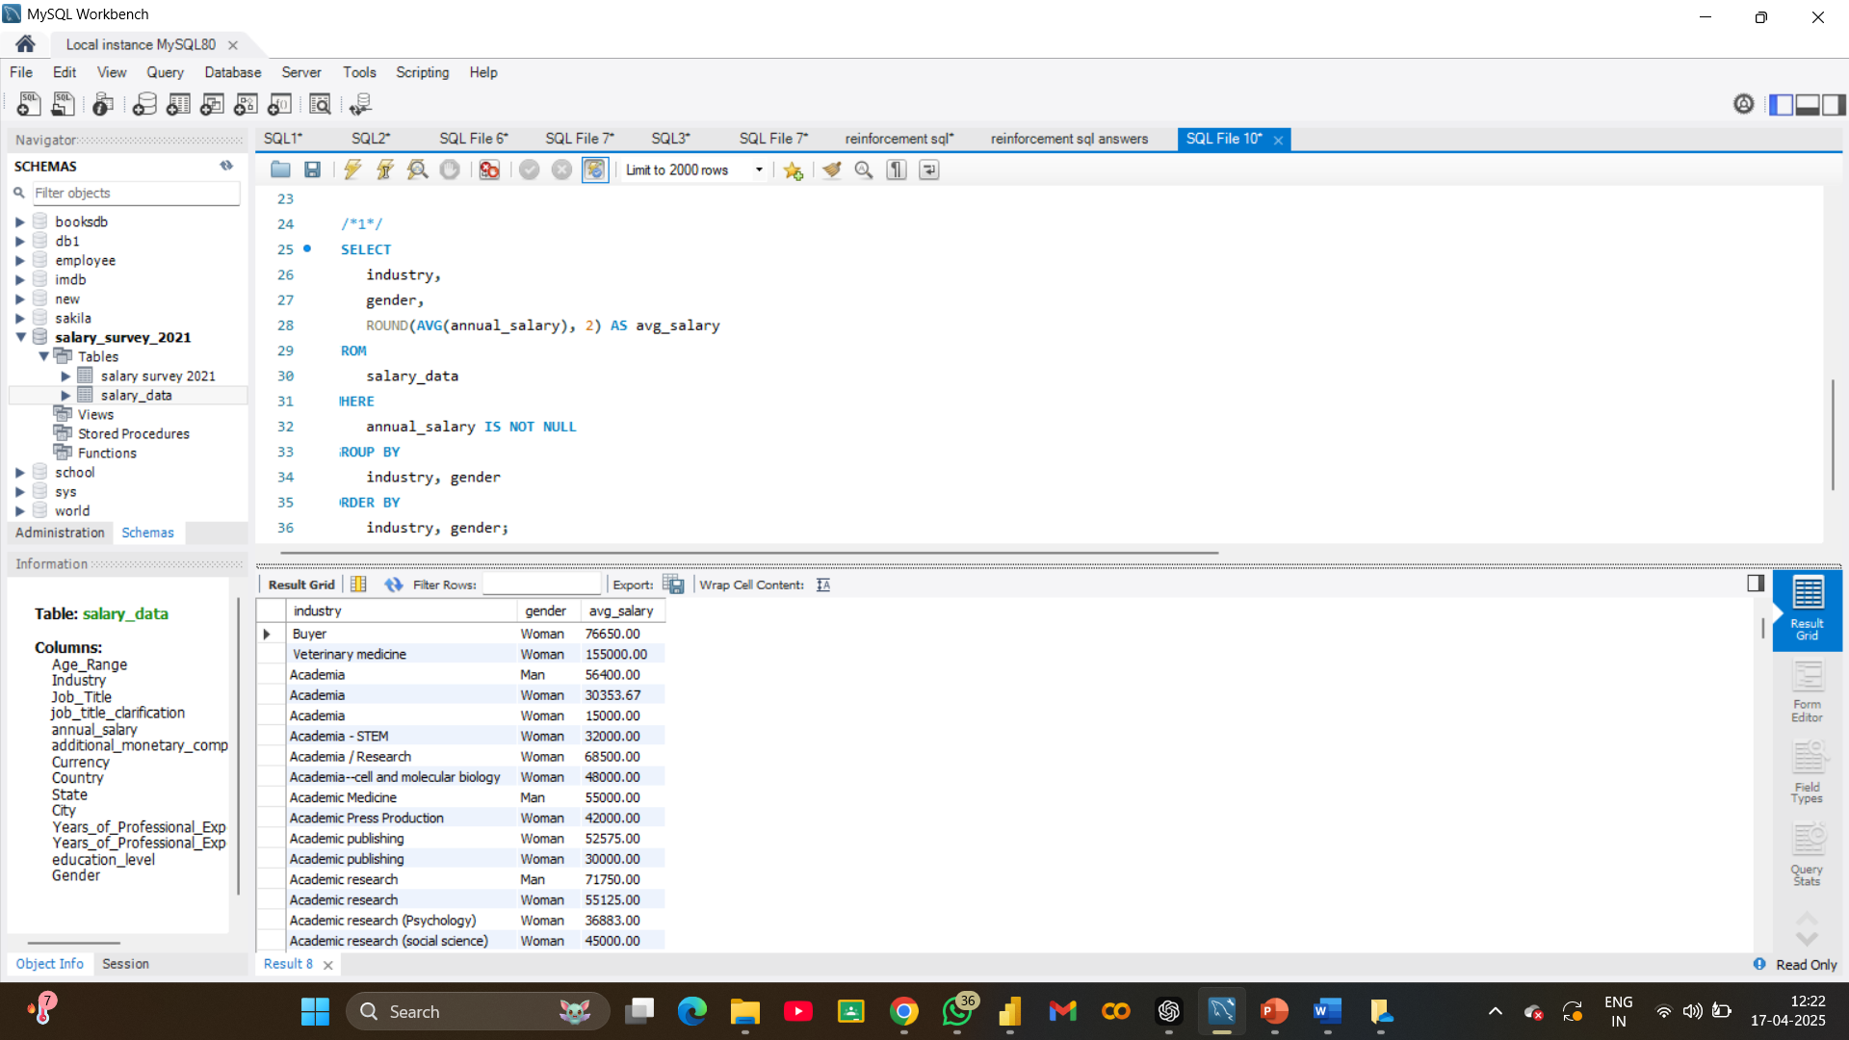
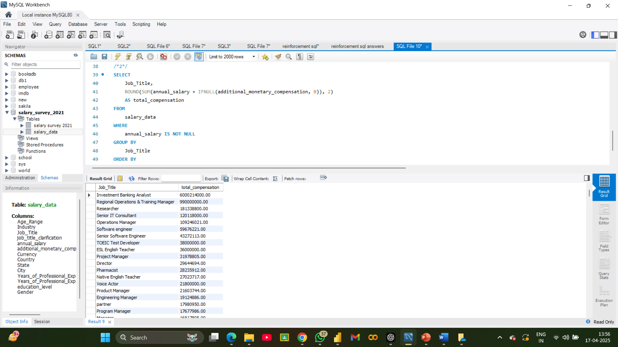
SQL QUERIES
a. Average Salary by Industry and Gender
b. Total Salary Compensation by Job Title

Slide 8
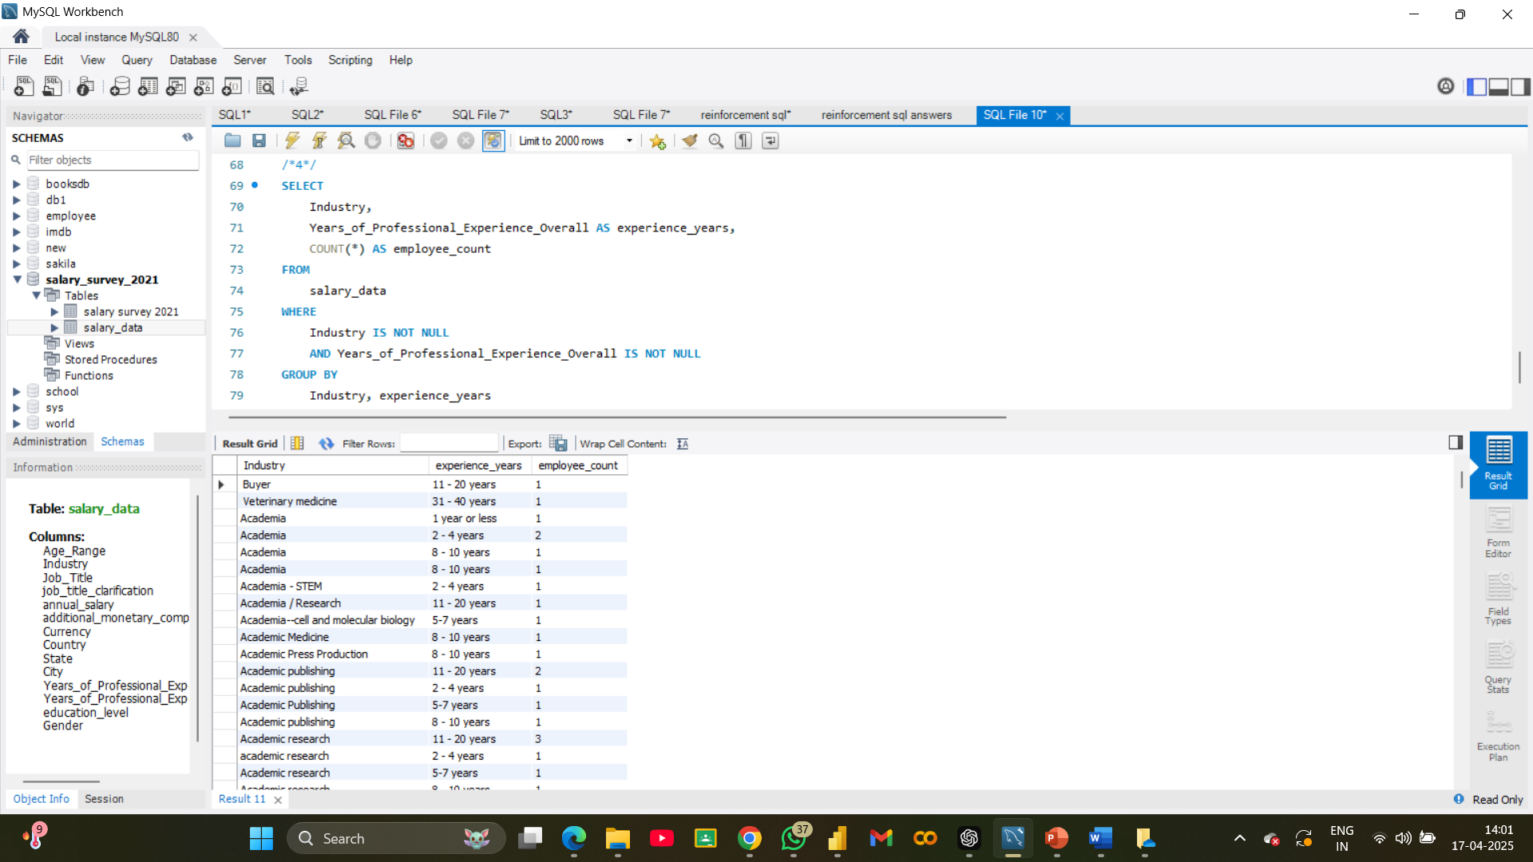
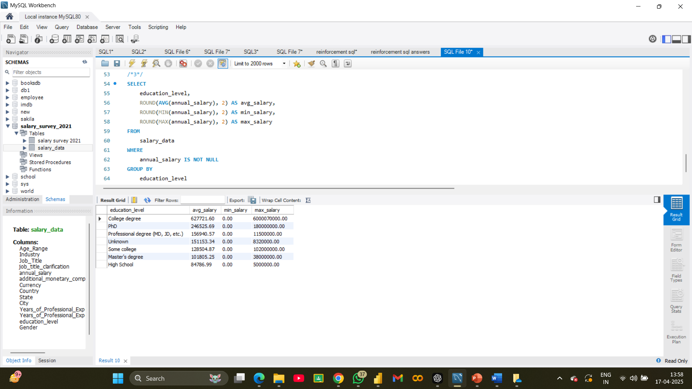
c. Salary Distribution by Education Level
d. Number of Employees by Industry and Years of Experience

Slide 9
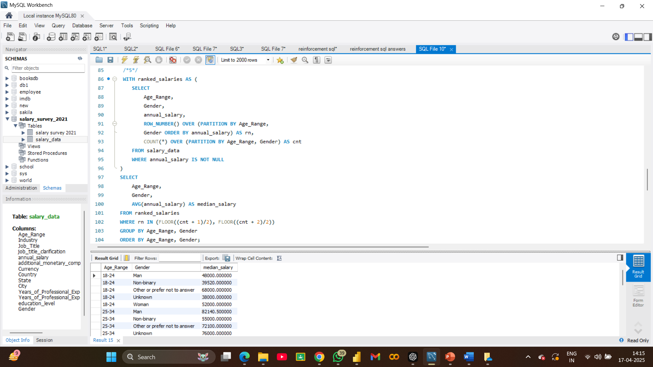
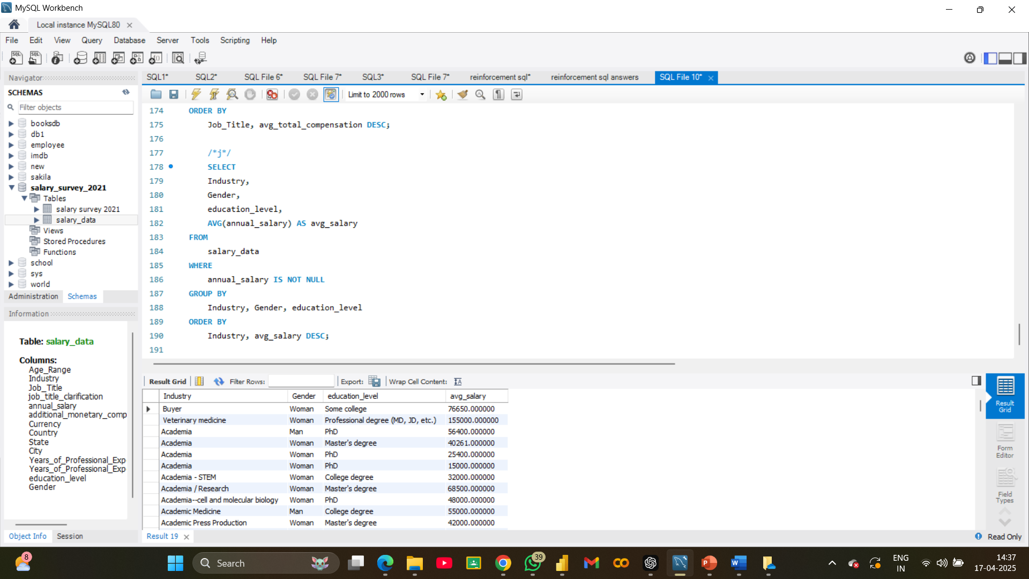
e. Average Salary by Industry, Gender, and Education Level
f. Median Salary by Age Range and Gender

Slide 10
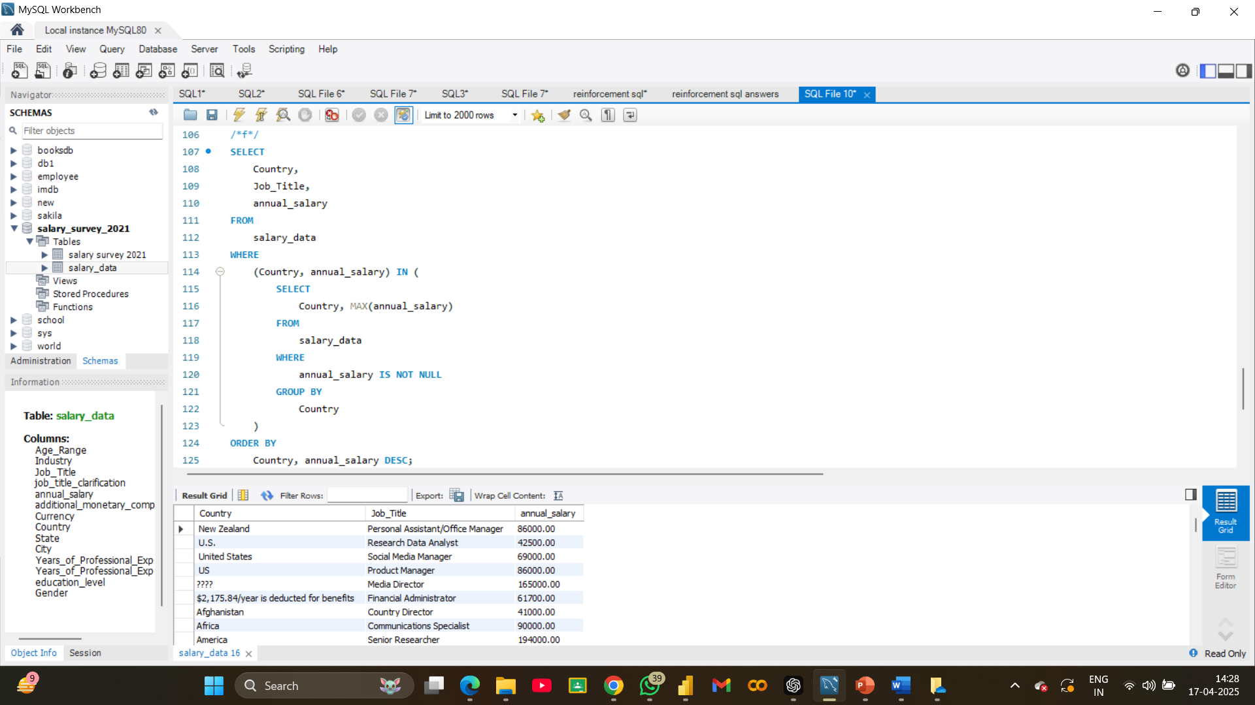
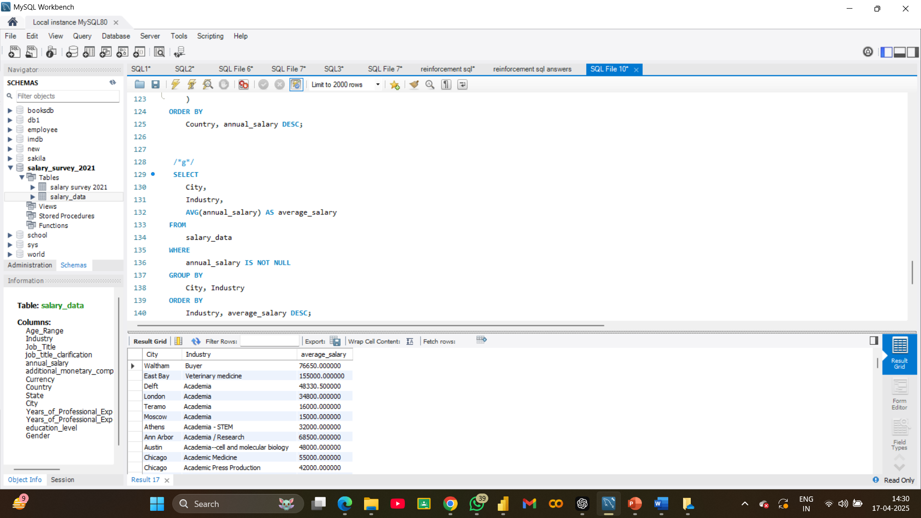
g. Job Titles with the Highest Salary in Each Country
h. Average Salary by City and Industry

Slide 11
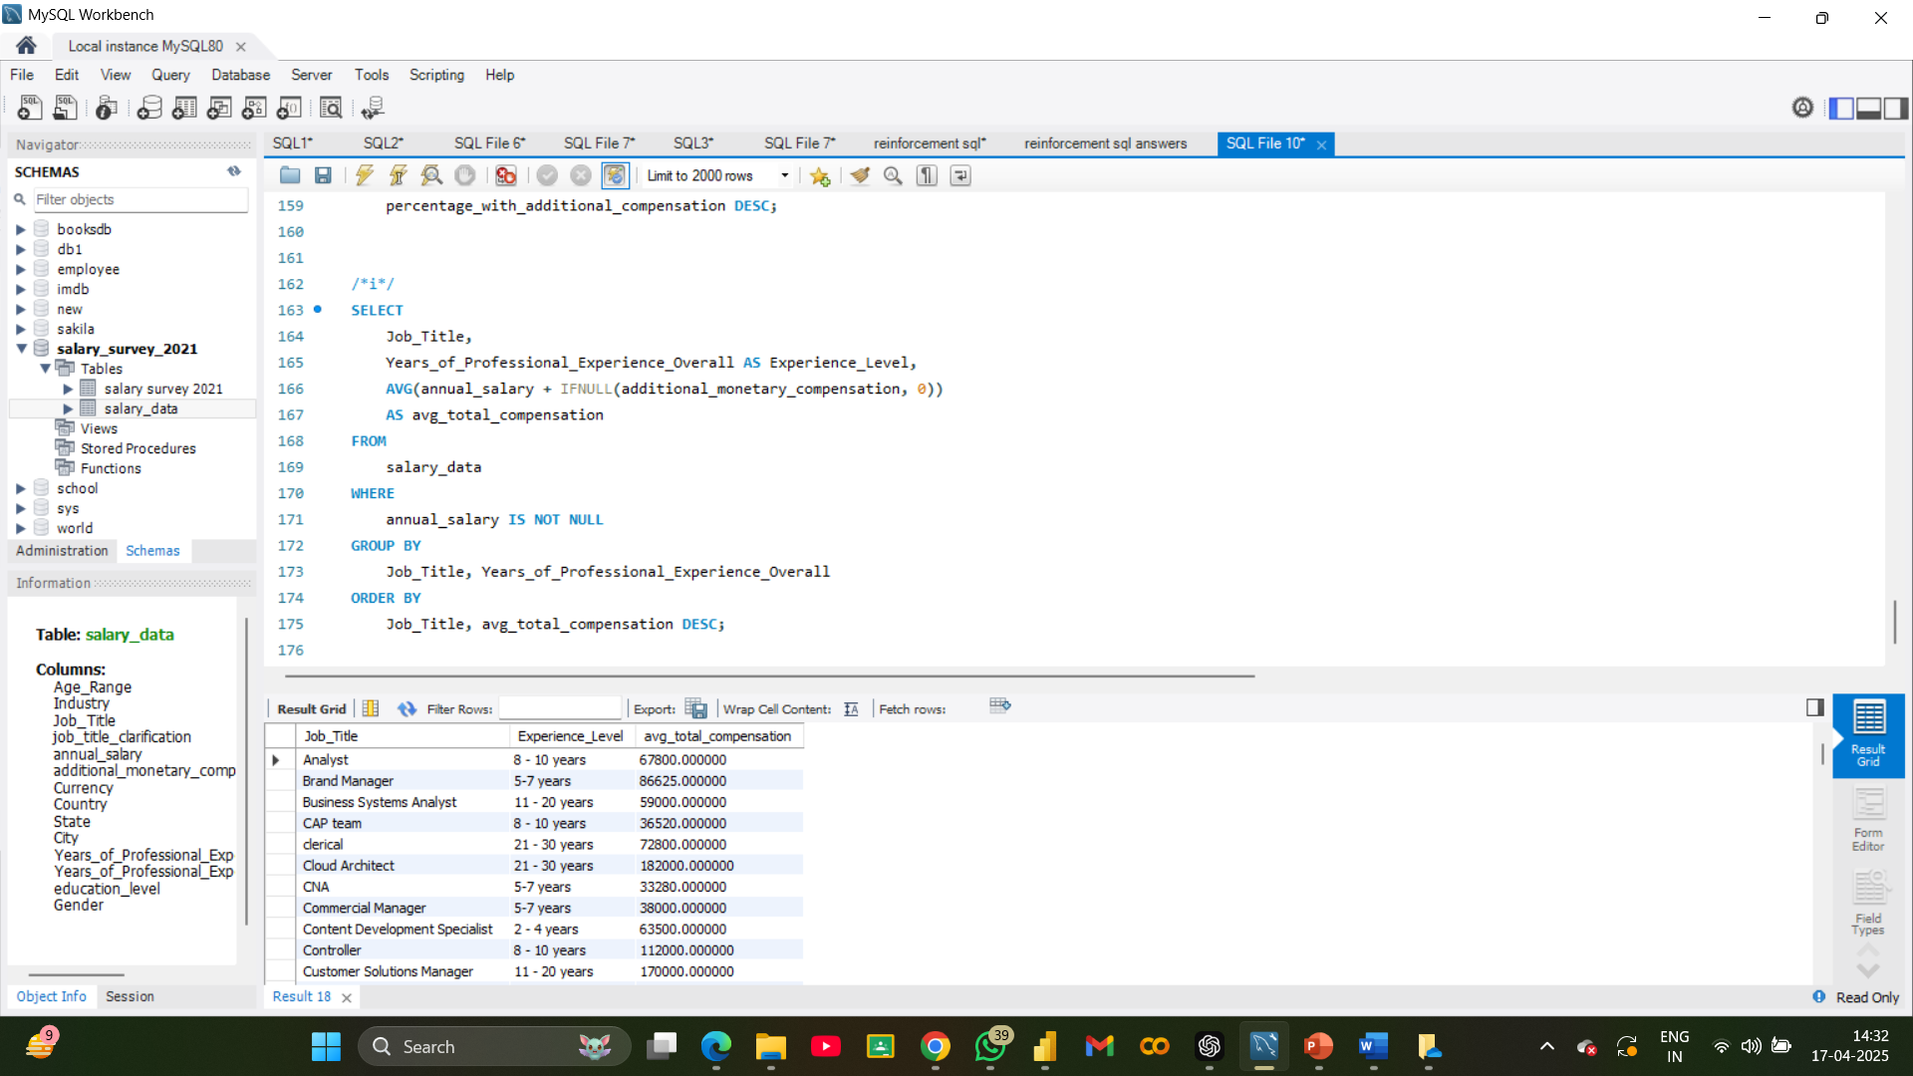
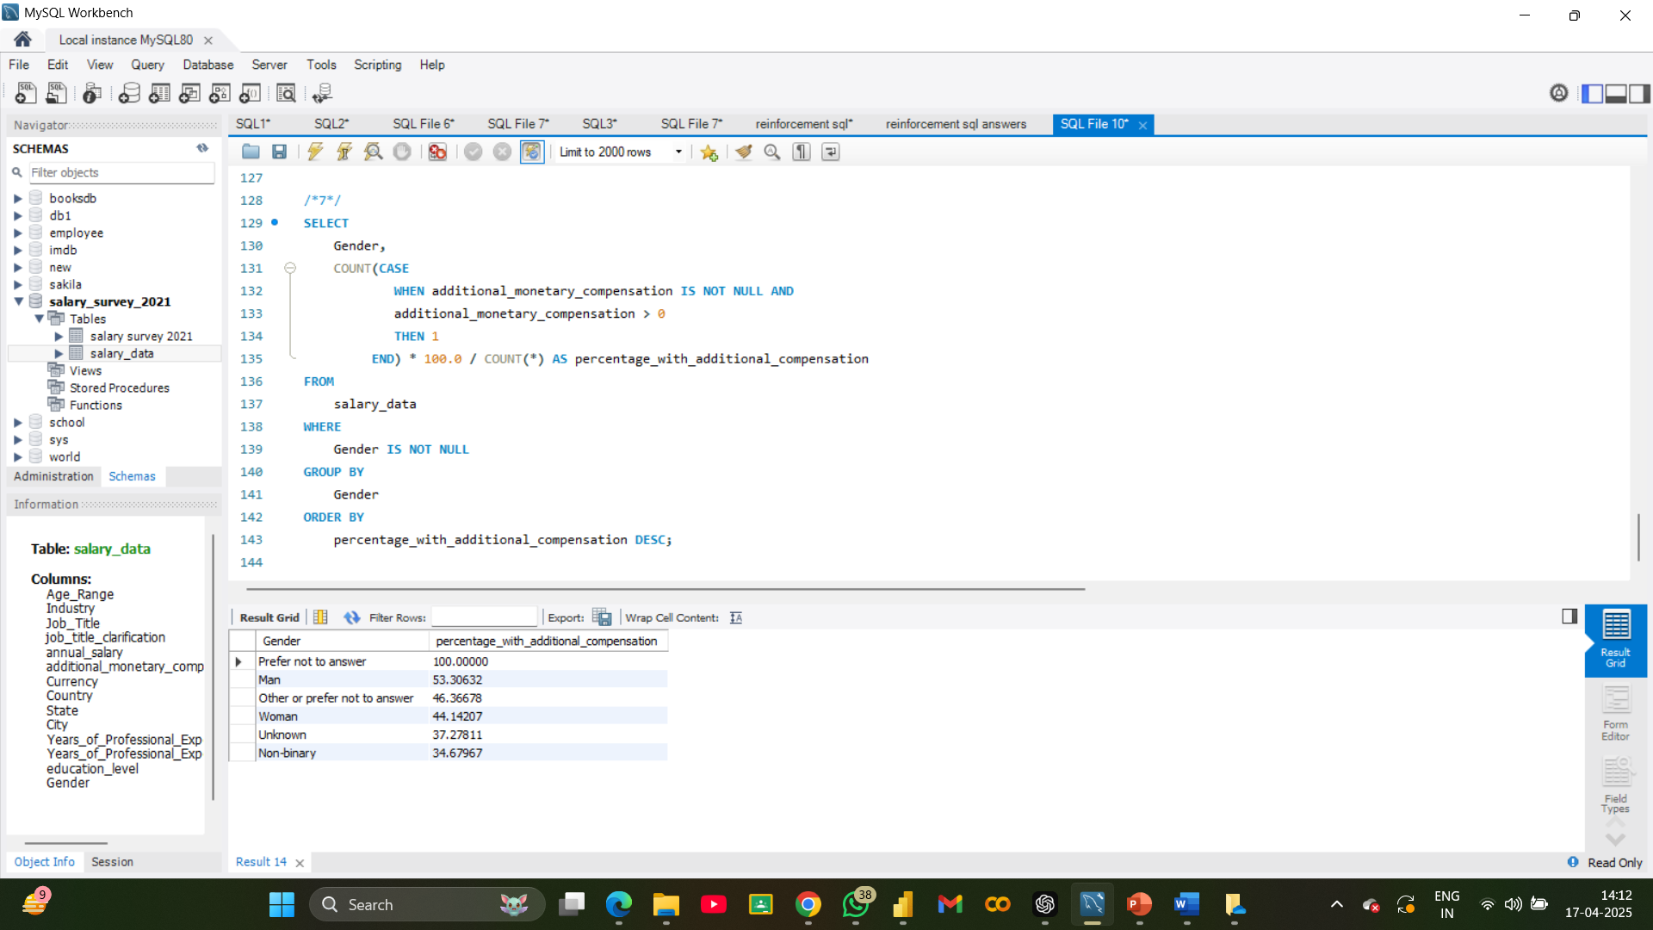
Total Compensation by Job Title and Years of Experience
j. Percentage of Employees with Additional Monetary Compensation by Gender

Slide 12
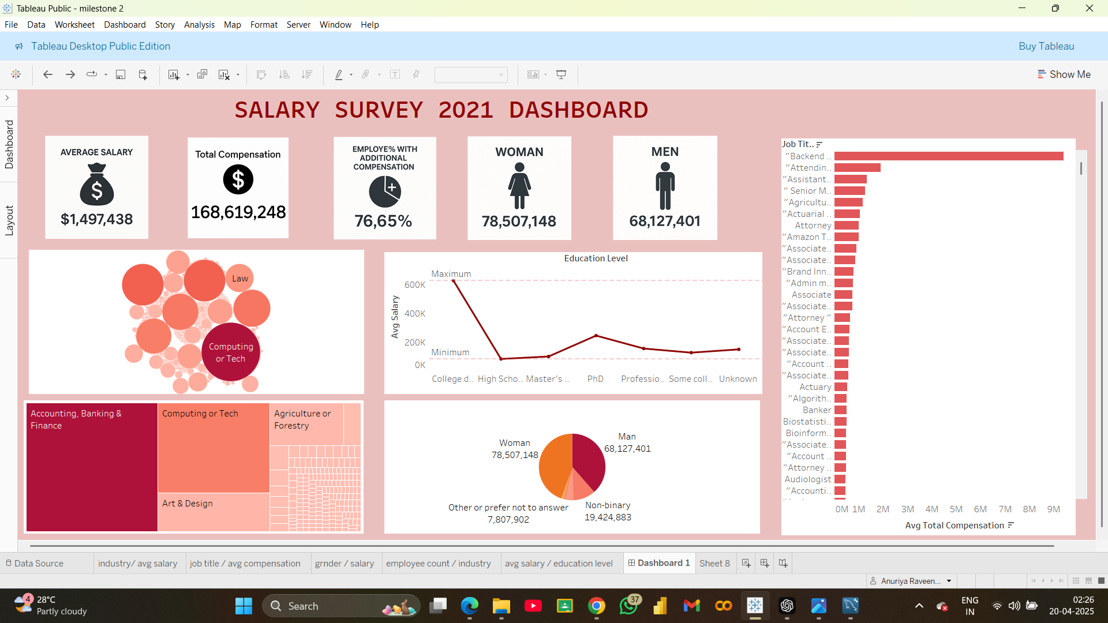

Slide 13
CONCLUSION
High Average Salary:
The average salary across all roles is $1,497,438, indicating a dataset likely skewed by high-income professionals.
Total Compensation:
Combined compensation amounts to $168.6 million, suggesting a large and diverse employee base.
Additional Compensation:
76.65% of employees receive extra compensation such as bonuses, stock options, etc.
Top Industries:
Accounting, Banking & Finance, Computing or Tech, and Law dominate in employee count and compensation.
Salary Inequality Potential:
The high average salary may be inflated by a few top earners, suggesting a right-skewed income distribution.
Industry Saturation:
Bubble charts reveal that Tech and Finance not only pay well but also employ more people.

Slide 14
THANK YOU!

